Slide 1
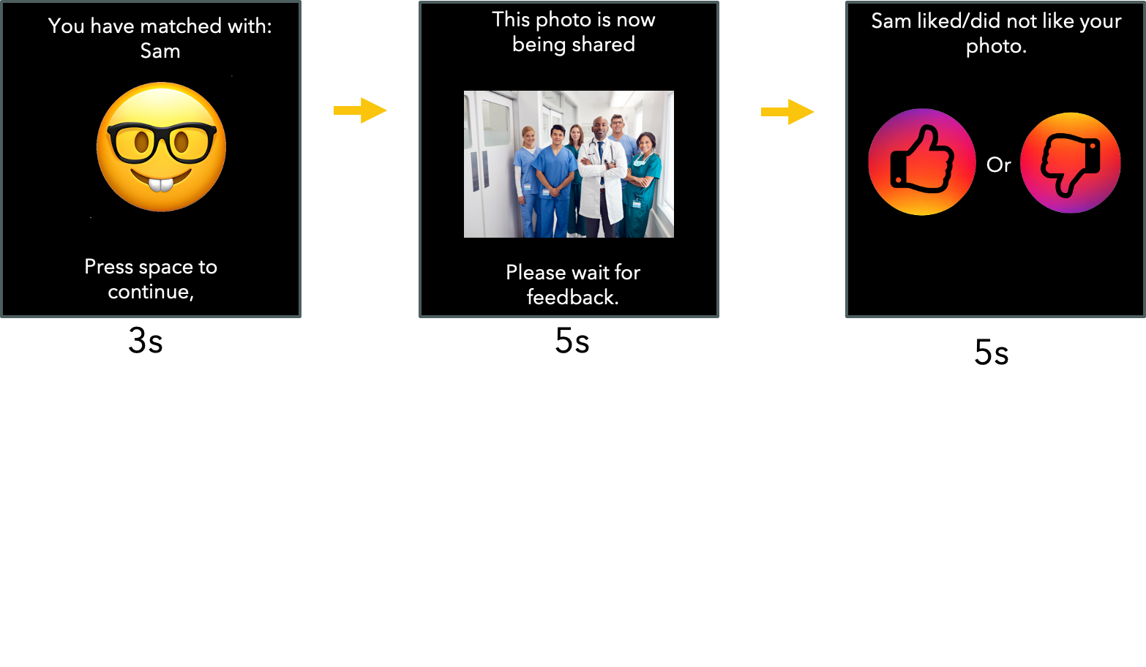
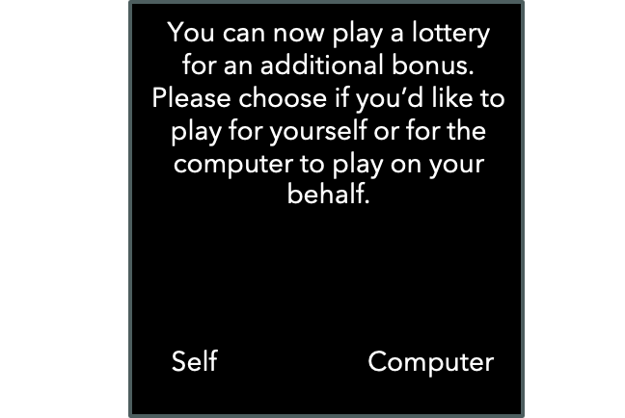

Slide 2
You have matched with: Sam
Press space to continue,
3s

Slide 3

This photo is now being shared
Please wait for feedback.
5s

Slide 4
Sam liked/did not like your photo.
Or
5s

Slide 5
You can now play a lottery for an additional bonus. Please choose if you’d like to play for yourself or for the computer to play on your behalf.
Self
Computer
3s

Slide 6
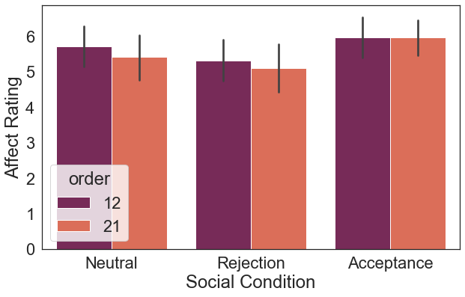

Slide 7
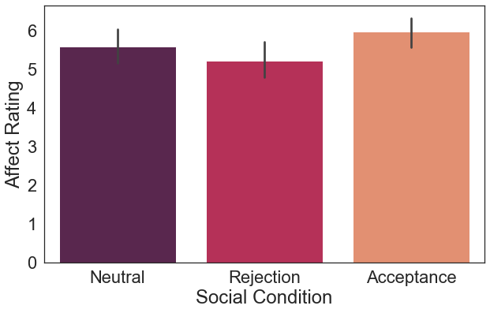
F(2,166) = 14.56, p <.001, f = .15
Rej x Acc t(83) = -5.05, p <.01, d = .4
Rej x Neu t(83) = -2.61, p <.01, d = .17
Neu x Acc t(83) = -3.01, p <.01, d = .2

Slide 8
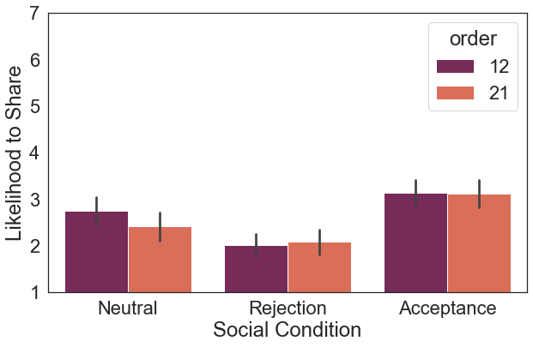

Slide 9
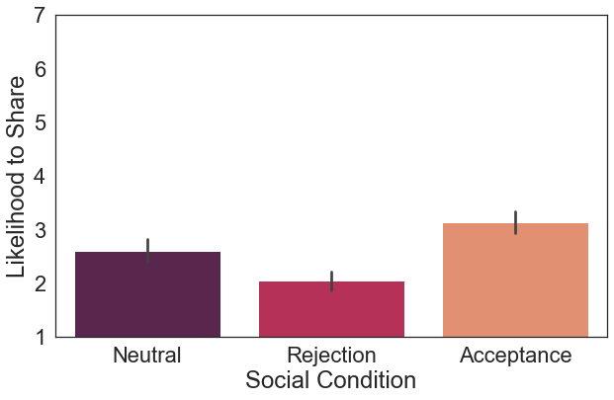
F(2,166 ) = 55.54 , p < .001 , f = .46
Rej x Acc t(83) = -10.68, p <.01, d = 1.23
Rej x Neu t(83) = -5.32, p <.01, d = .6
Neu x Acc t(83) = -5.15, p <.01, d = .54

Slide 10
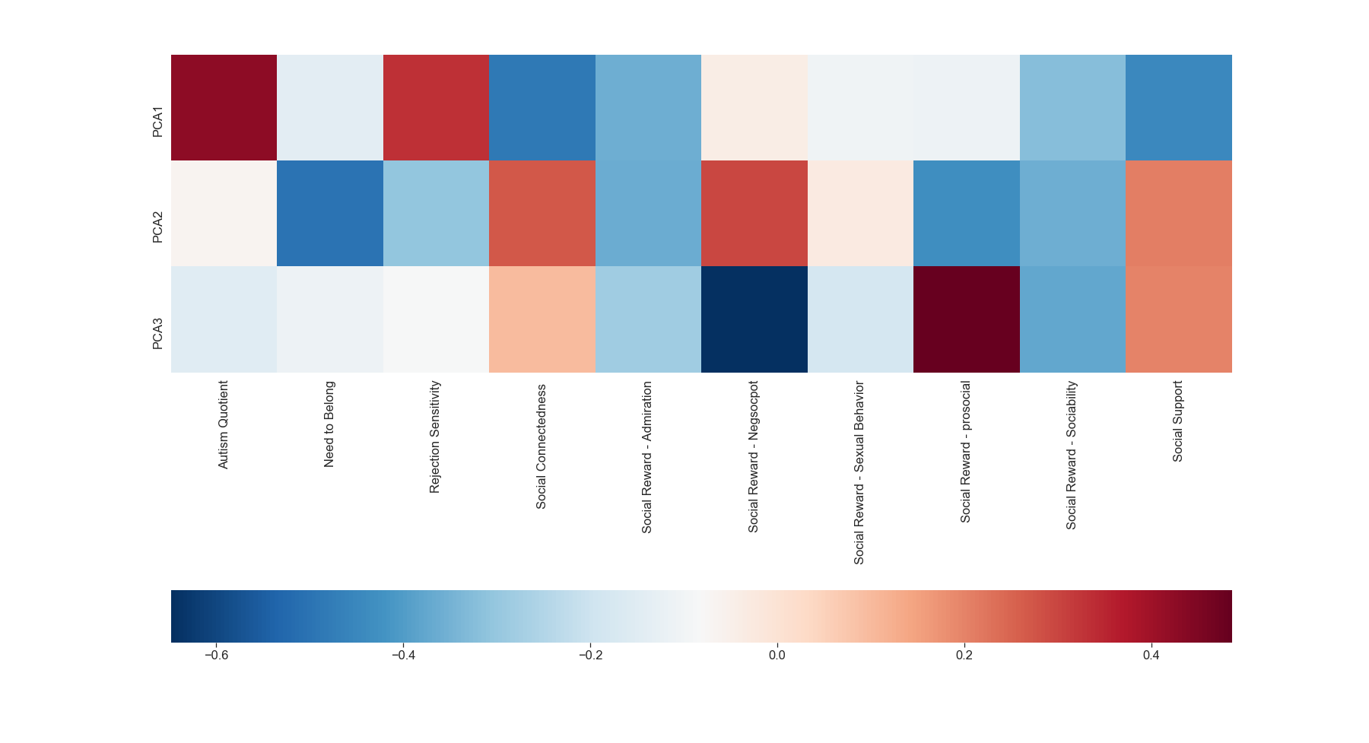

Slide 11
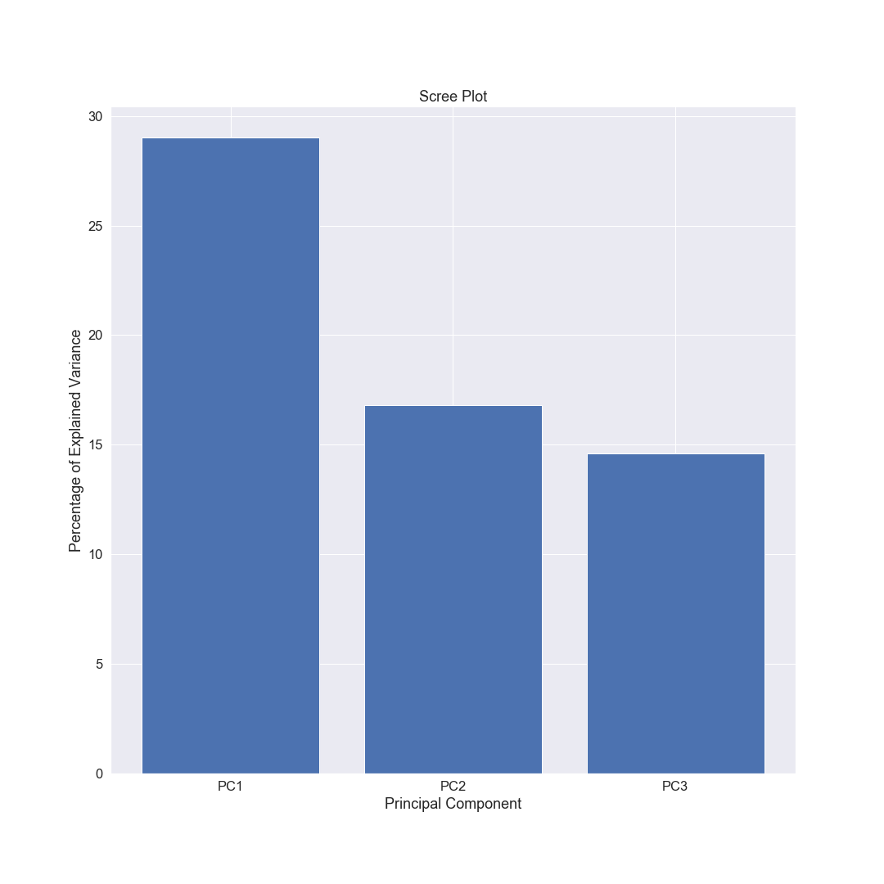

Slide 12
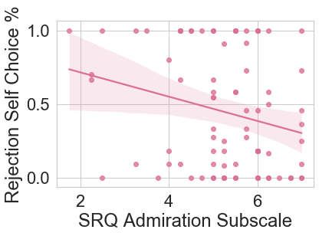
r(83) = -.22, p <.05*

Slide 13
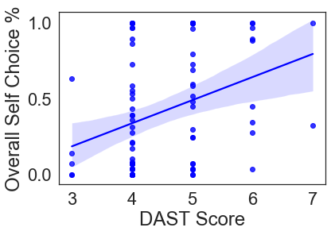
r(83) = .34, p <.01

Slide 14
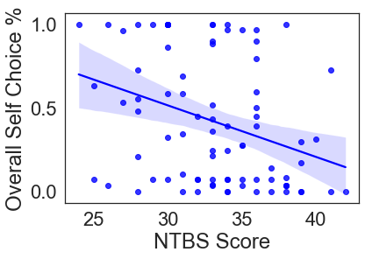
r(83) = -.35, p <.01

